Slide 1

VOLUME 2
MODULE 4
GRADE 5-6
SESSION 1– Dealing with Absent Mindedness

Slide 2


CLASS ROOM RULES !
Participate by listening actively and paying attention.
Do not mass answer and wait for your turn.
Respect other people’s feelings and time.
Implement the SOCH learning.
Accept feedback and make necessary changes for self .

Slide 3


Would you rather !!!!
Let’s choose….
https://youtu.be/4xXItQSdfug?t=249
Notes:
https://youtu.be/4xXItQSdfug?t=249

Slide 4


WHAT IS ABSENT MINDEDNESS?
Notes:
Someone who is absent-minded often forgets things or does not pay attention to what is happening near them because they are thinking about other things.

Slide 5
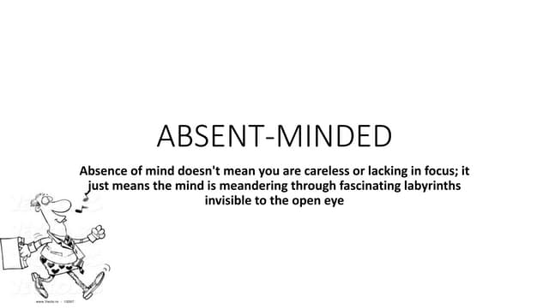
MORE ABOUT IT……….
Notes:
Our mind is continuously processing a thousand thoughts, we tend to think about a lot of things at the same time in our subconscious mind , hence sometimes we miss onto important things being told to us at that moment.

Slide 6

WHY DO WE FORGET ???
Notes:
Students must give their reasons of what do they think about why do we forget ?

Slide 7

WHAT WE THINK WE FORGET?
Notes:
Discussion on what all things students tend to forget , example, they go and open refrigerator and forget why they have opened it, orthey go to a room to find something and forget what they are looking for.

Slide 8



VIDEO TIME!!!
https://youtu.be/7GI4eTUyGSM?t=156
Notes:
https://youtu.be/7GI4eTUyGSM?t=156

Slide 9

TAKE AWAY !
WHAT IS ABSENT MINDEDNESS?
THINGS THAT WE TEND TO FORGET OFTEN
WHY DO WE FORGET

Slide 10




